Slide 1
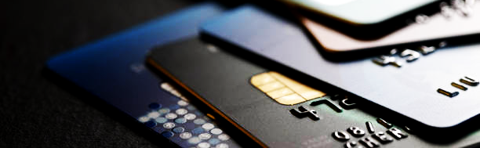
BetterSwipe
CS411 Spring 2024
Prototype Demo #1
Team Blue Team Members: Marcelo Vargas, Cody Cochran, Rich Connor, Christian Euell, Albert Ayitey-Adjin, John Cartwright, Ben Paul

Slide 2
The planning approach (How is this going to get done?)
Front-end: Richard, Albert, Marcelo and Christian will collaboratively engage in the initial configuration of the BetterSwipe application, focusing on critical components such as Login/registration, Home, Dashboard, and Card Composition. This endeavor will be executed leveraging the capabilities of React.js, a powerful and widely used JavaScript library for building user interfaces.
Back-end: Cody, Ben, Marcelo, and John will be working on the Expense Profile,

Slide 3








Implementation Tools
Front-End | React
Back-End | Django
Database | Microsoft SQL Server
Deployment Environment | Docker
Version Control/Repository | GitHub
File Sharing | Google Cloud
Project Management/Sprint Plan | Trello

Slide 4

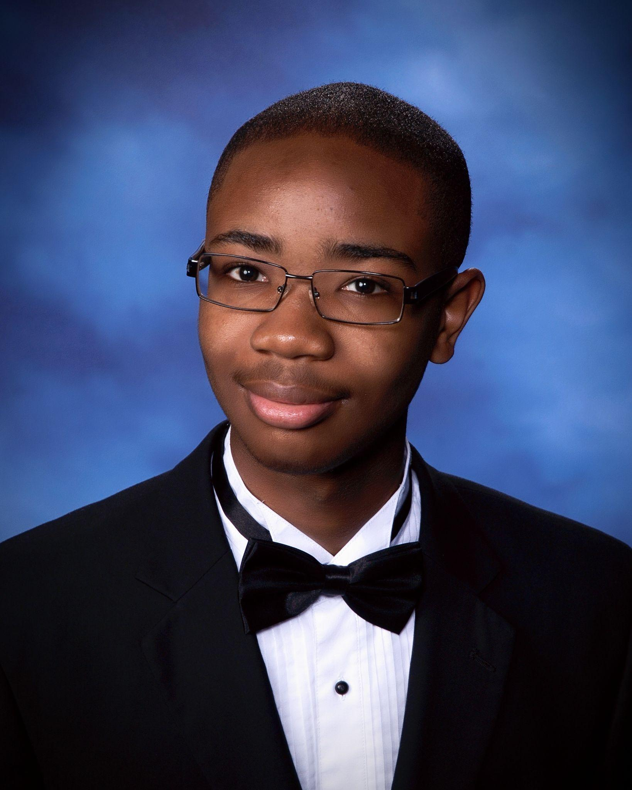


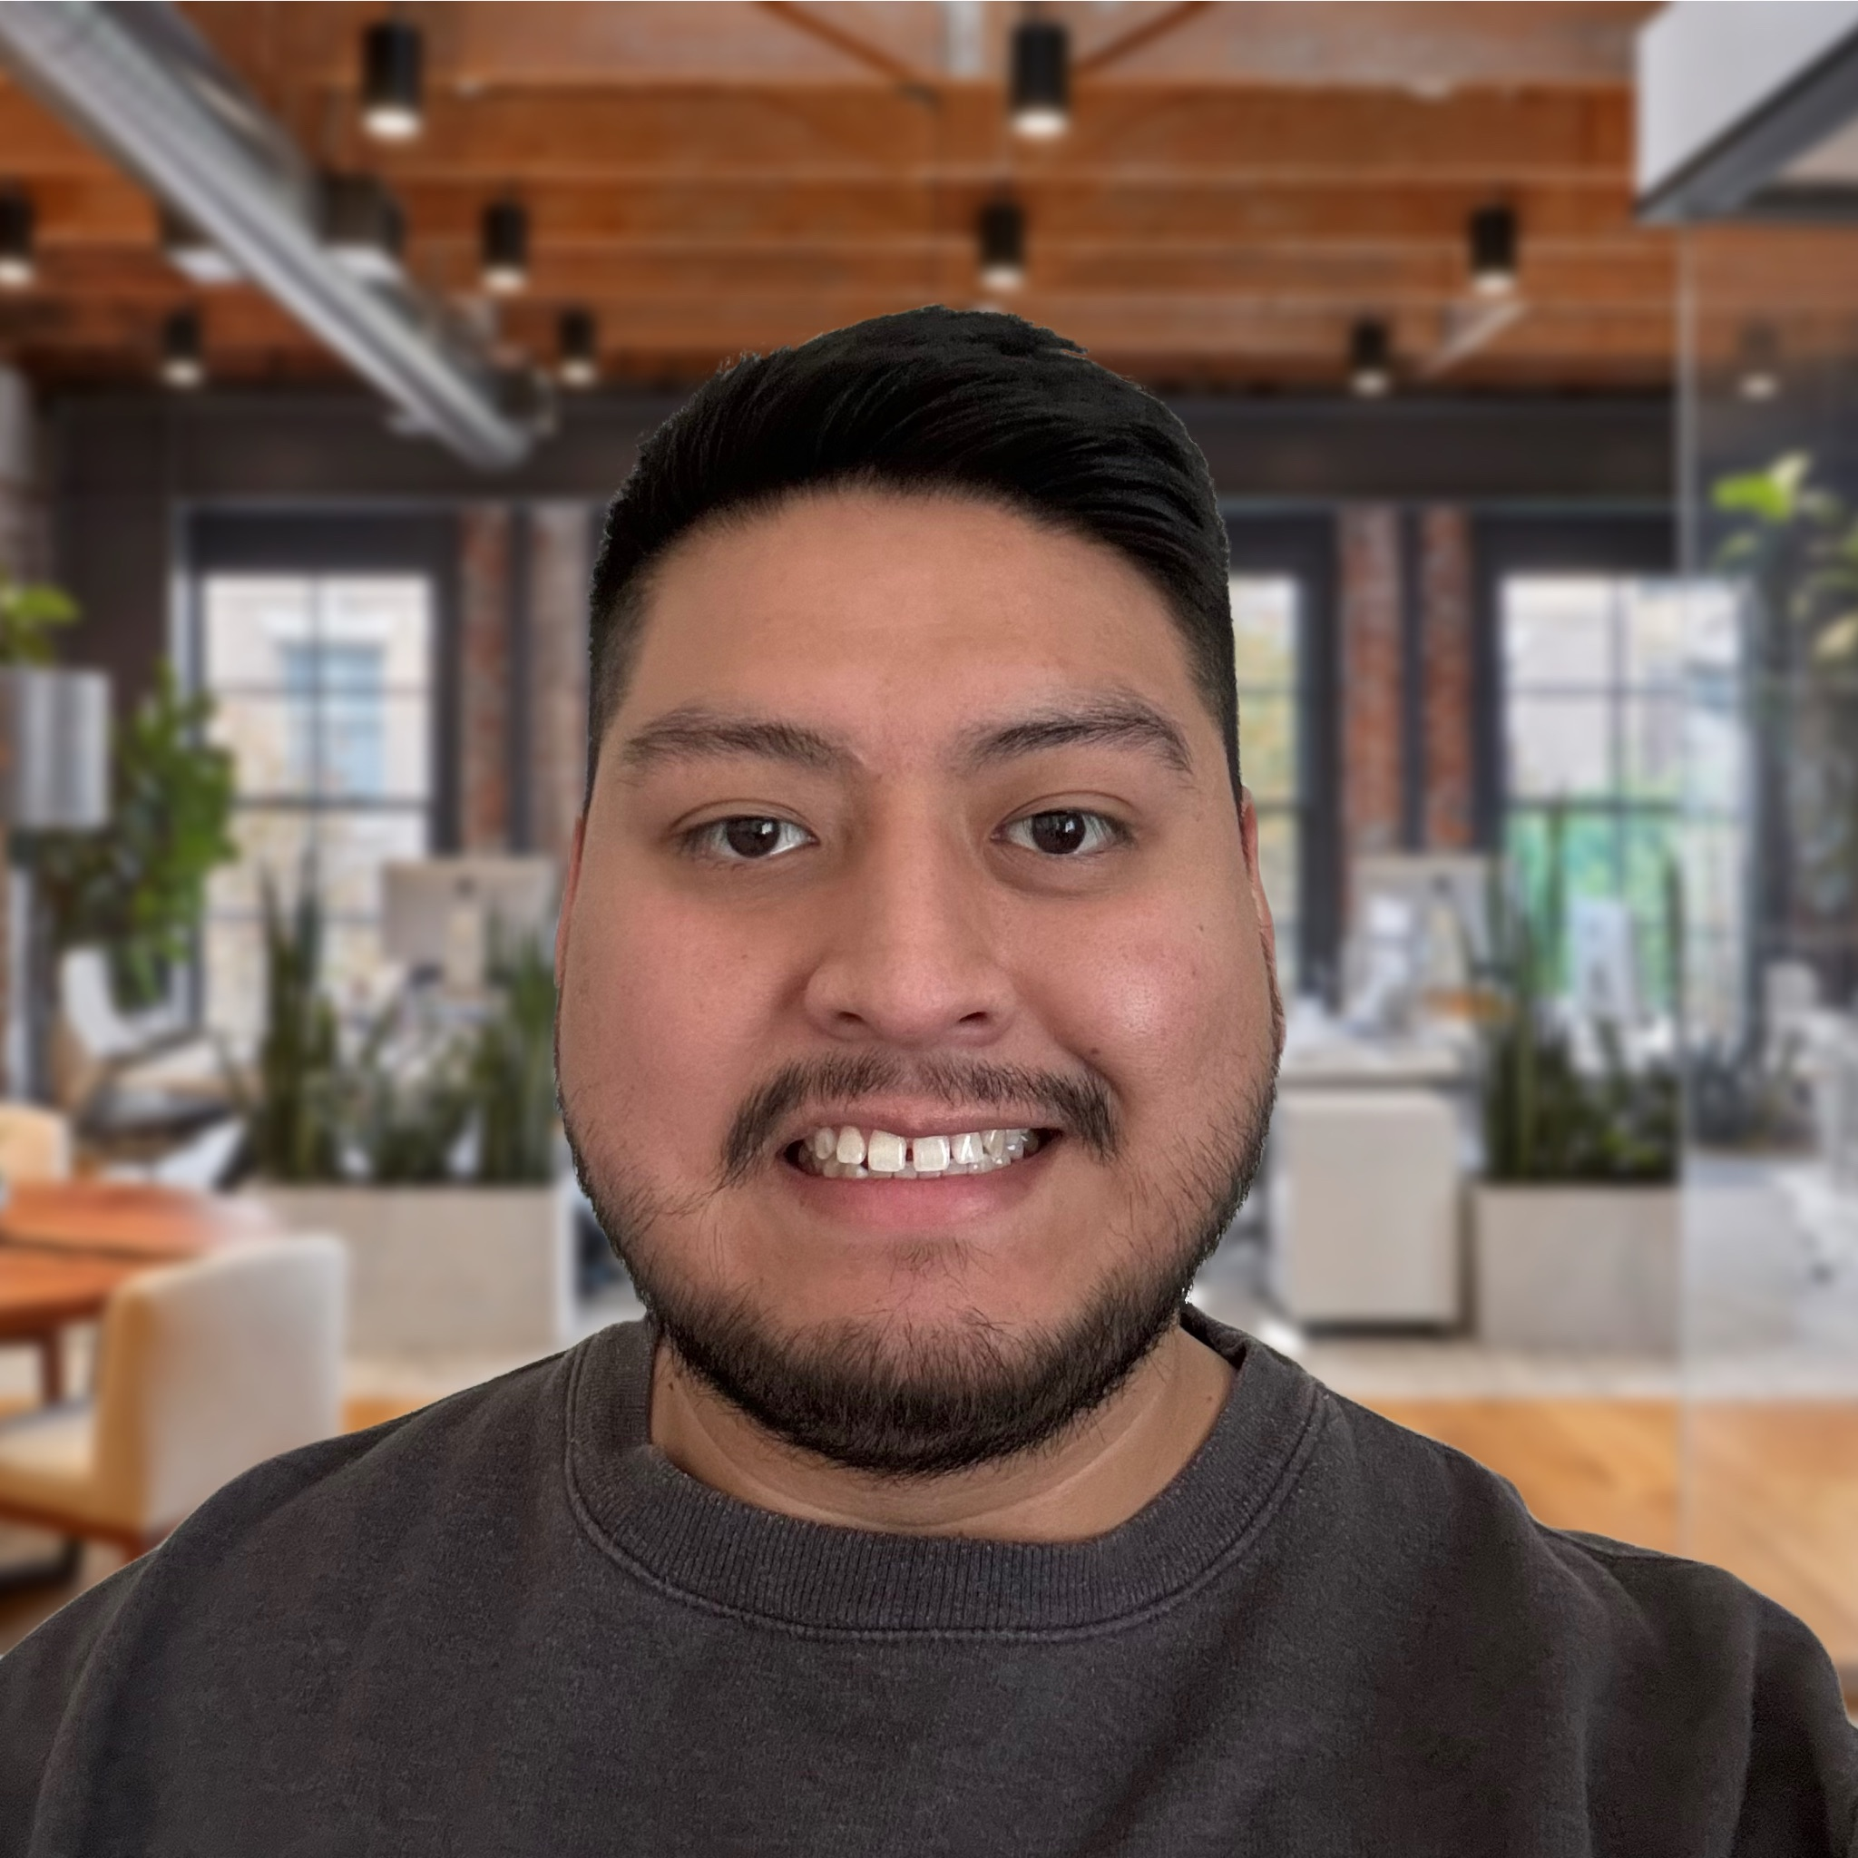

Team Roles and Responsibilities | Albert Front end Card Comparison
Ben | Christian Front end Documentation Specialist Login/Registration
Cody Back end | John Back End Expense Profile
Marcelo Full Stack Developer Database Engineer | Richard Front end Home/Dashboard

Slide 5
Sprint/Task Breakout/Schedule Timeline (Gantt)
Sprint 0 (weeks 1-4)
Establish development environment
Account Roles/Authentication
DB Design
UI Scaffolding
Sprint 2 (weeks 8-10)
homepage/login/signup
Integrate upload page
Database integration for accounts
Sprint 4 (weeks 14-16)
Final integration
Full functional testing
Sprint 1 (weeks 5-7)
UI .csv. File Upload
Backend integration for file upload
DB refinement
Sprint 3 (weeks 11-13)
Dashboard/Card Comparison UI
Algorithms to process data and provide recommendations
Continued integration and testing

Slide 6
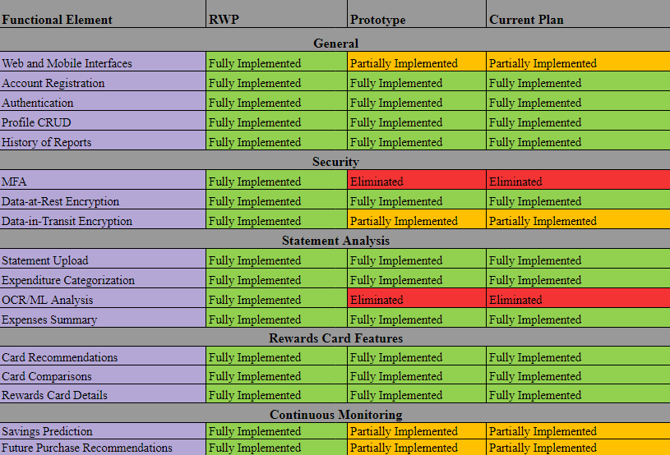
RWP=>Original Prototype=>Current Plan Features table
Functional Element | Real World Product (RWP) | Prototype | Current Plan | Reason
Login/Register | Full Functionality | Full Functionality
Feature encryption | Full Functionality | Full Functionality
Statement Upload | Full Functionality | Partial Functionality |  | Only accepts Excel-compatible format
Categorization of expenditures | Full Functionality | Partial Functionality |  | Combination of ML and adjustments
Download rewards details for credit cards cards | Full Functionality | Partial Functionality |  | Stimulating data from a real database baseline
Expenditure Profile Creation/Maintenance | Full Functionality | Full Functionality
Card Recommendations/Comparisons | Full Functionality | Full Functionality
Continuous Monitoring of expenditures/cards | Full Functionality | Partial Functionality |  | Using simulated data
Continuous Monitoring of expenditures/cards | Full Functionality | Full Functionality

Slide 7
User stories with changes identified
As a user, I would like an adaptive interface that can fit to the size of my screen
As a user, I would like to have my own account
As a user, I would like to be able to name my account
As a user, I would like to be able to create a password of my choosing
As a user, I would like my account to be locked unless I type in the password previously established with my account
As a user I would like to be able to make changes to my account settings.
As a user, I would like to see my past transactions and rewards history
As a user, I would like to see my past transactions and rewards history
As a user, I would like to see a history of my past results.
As a user, I would like my personal and banking information to be secure transmitted and stored when it is stored.
As a user, I would like my personal and banking information to be secure transmitted and stored when it is in transit.
As a user, I would like to be able to scan upload my bank statement so I don’t have to type in all of my purchases by hand.
As a user, I would like to be able to periodically upload more statements after the initial use.
As a user, I would like to be able to see all my transactions categorized.
As a user, I would like to see a summary of how much I have been spending in each category.
As a user, I would like for recommendations to be personalized to match my necessities and spending history.
As a user, I would like constant updated recommendations of rewards cards based on my constantly updated bank statements.
As a user, I would like to be able to see the top 3 recommended cards compared side-by-side, so I have alternate options if I don’t like the top recommendation.
As a user, I want to be able to see information about the rewards cards, such as APR and specifics about the rewards offered.
As a user, I would like to receive a general summary of how much I would earn if I selected one of the suggested cards used a selected rewards credit card.
As a user, I would like to be able to add information about future purchases so that they will be considered with savings predictions.
As a user, I would like to receive reminders of rewards that I have and where I can apply them with purchases I am already making.

Slide 8
User Stories ⇔ Feature mapping
Feature | User Story
General
Web and Mobile Interfaces | As a user, I would like an adaptive interface that can fit to the size of my screen
Account Registration | As a user, I would like to have my own account As a user, I would like to be able to name my account As a user, I would like to be able to create a password of my choosing
Authentication | As a user, I would like my account to be locked unless I type in the password previously established with my account.
Profile CRUD | As a user I would like to be able to make changes to my account settings.
History of Reports | As a user, I would like to see my past transactions As a user, I would like to see my rewards history
Security
Data-at-Rest encryption | As a user, I would like my personal and banking information to be secure when it is stored.
Data-in-Transit encryption | As a user, I would like my personal and banking information to be secure when it is in transit.
Statement Analysis
Statement Upload | As a user, I would like to be able to upload my bank statement so I don’t have to type in all of my purchases by hand. As a user, I would like to be able to periodically upload more statements after the initial use.
Expenditure Categorization | As a user, I would like to be able to see all my transactions categorized.
Expenses Summary | As a user, I would like to see a summary of how much I have been spending in each category.
Reward Card Features
Card Recommendations | As a user, I would like for recommendations to be personalized to match my necessities and spending history. As a user, I would like updated recommendations of rewards cards based on my updated bank statements.
Card Comparisons | As a user, I would like to be able to see the top 3 recommended cards compared side-by-side, so I have alternate options if I don’t like the top recommendation.
Rewards Card Details | As a user, I want to be able to see information about the rewards cards, such as APR and specifics about the rewards offered.
Continuous Monitoring
Saving Prediction | As a user, I would like to receive a general summary of how much I would earn if I used a selected rewards credit card.
Future Purchase Recommendations | As a user, I would like to be able to add information about future purchases so that they will be considered with savings predictions. As a user, I would like to receive reminders of rewards that I have and where I can apply them with purchases I am already making.

Slide 9
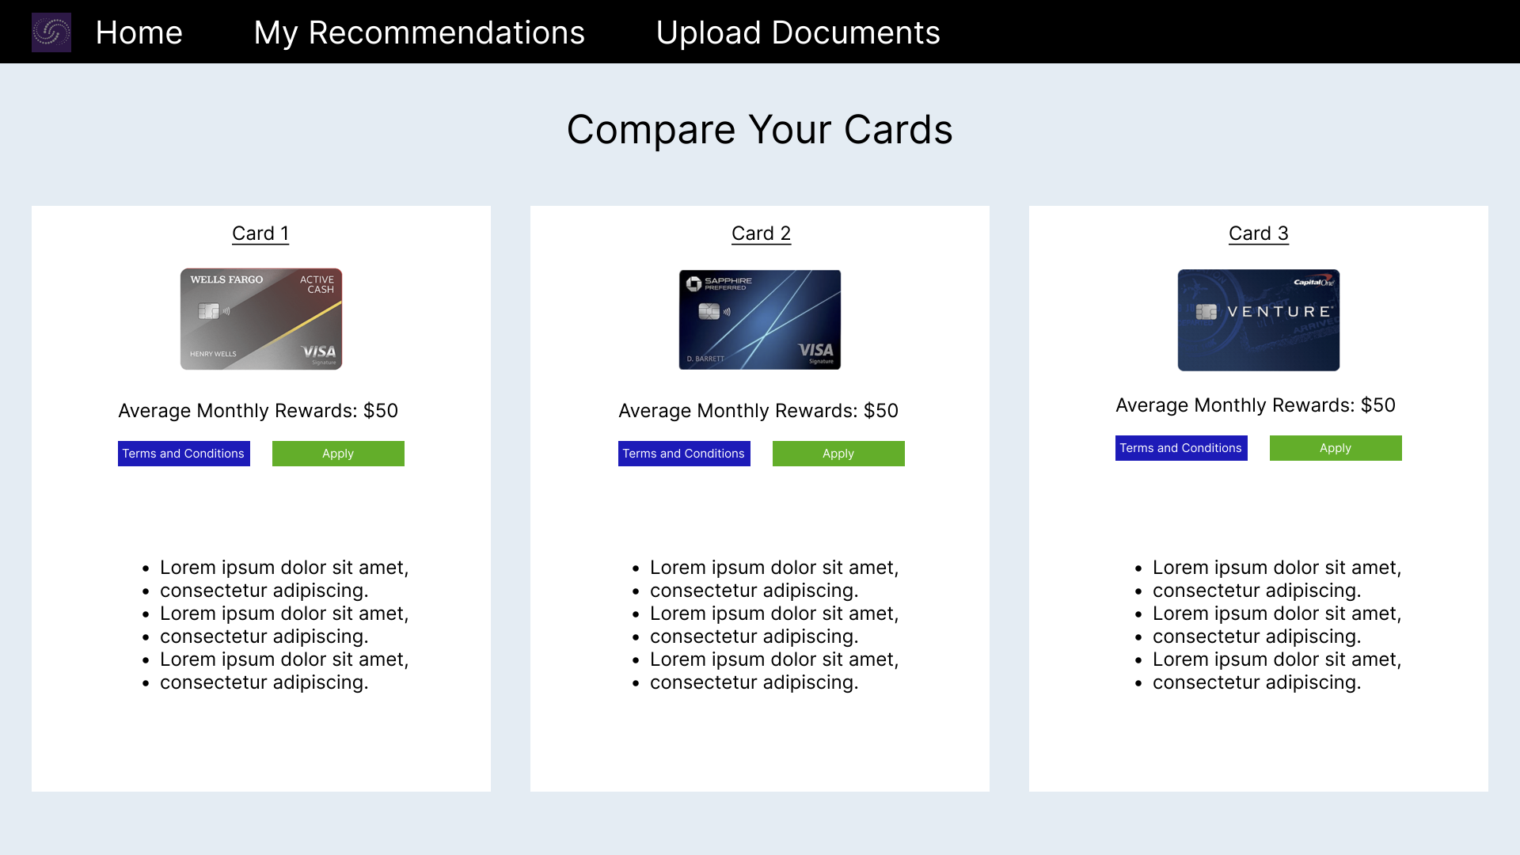
UI Mockup review

Slide 10
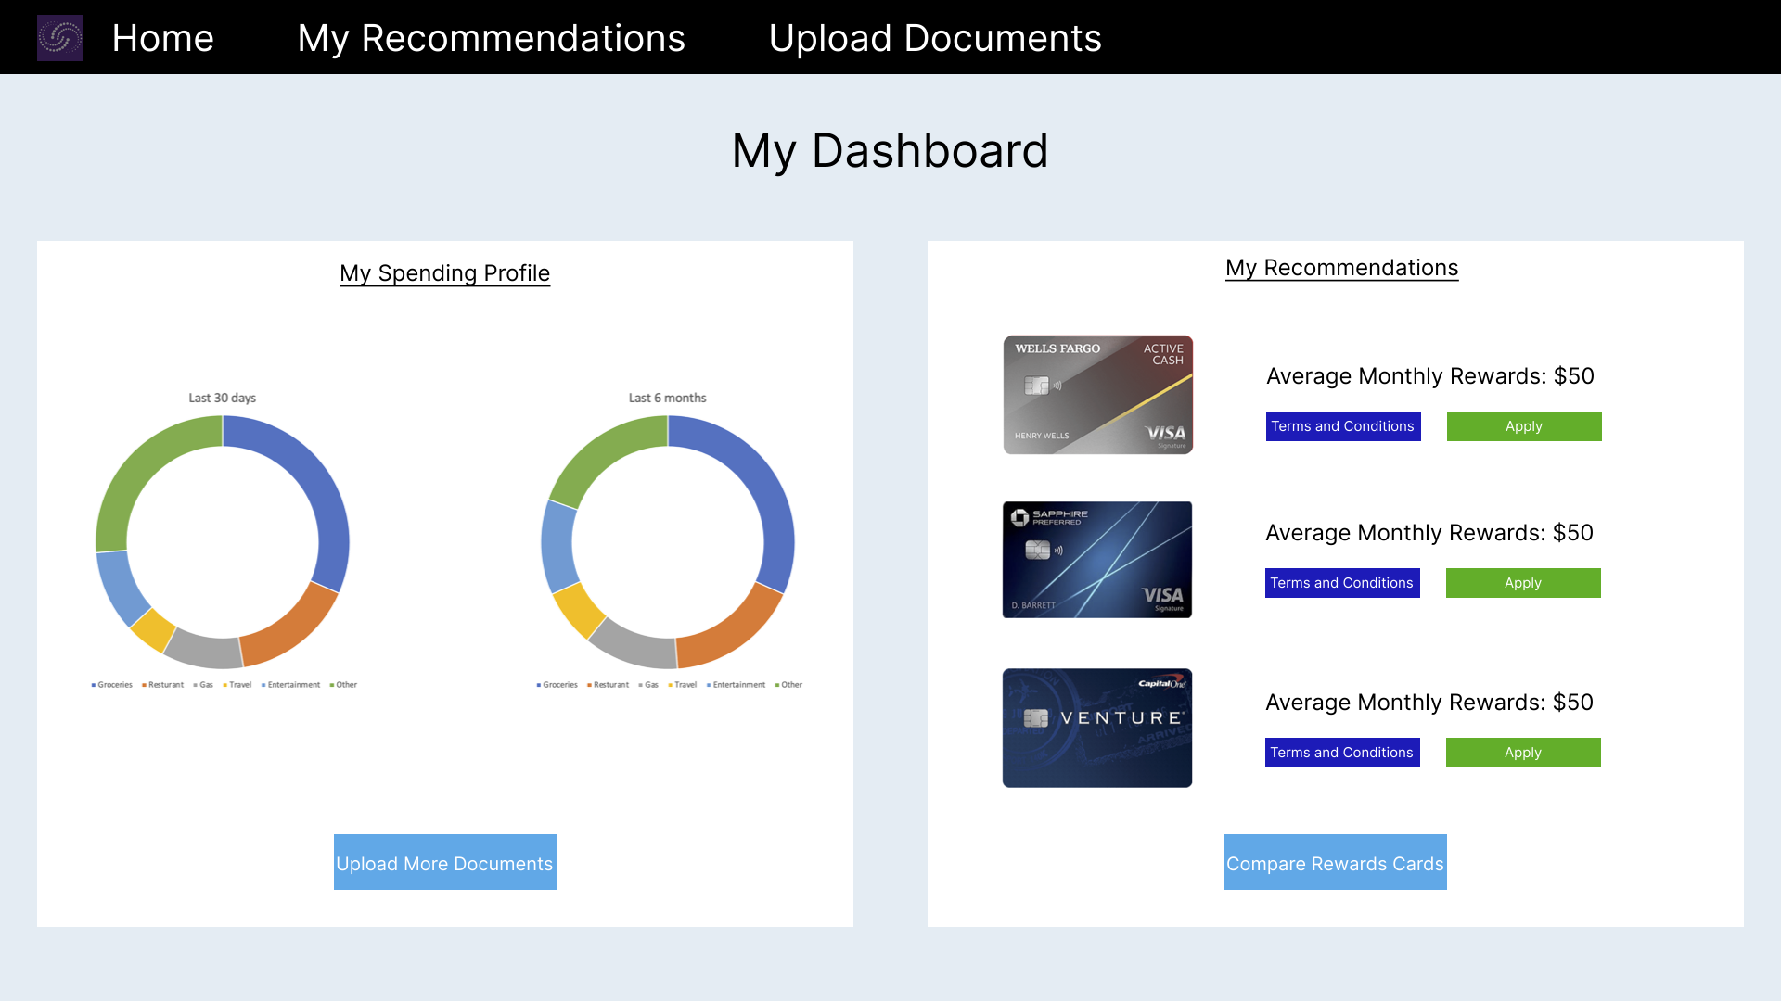
Dashboard: RWP

Slide 11
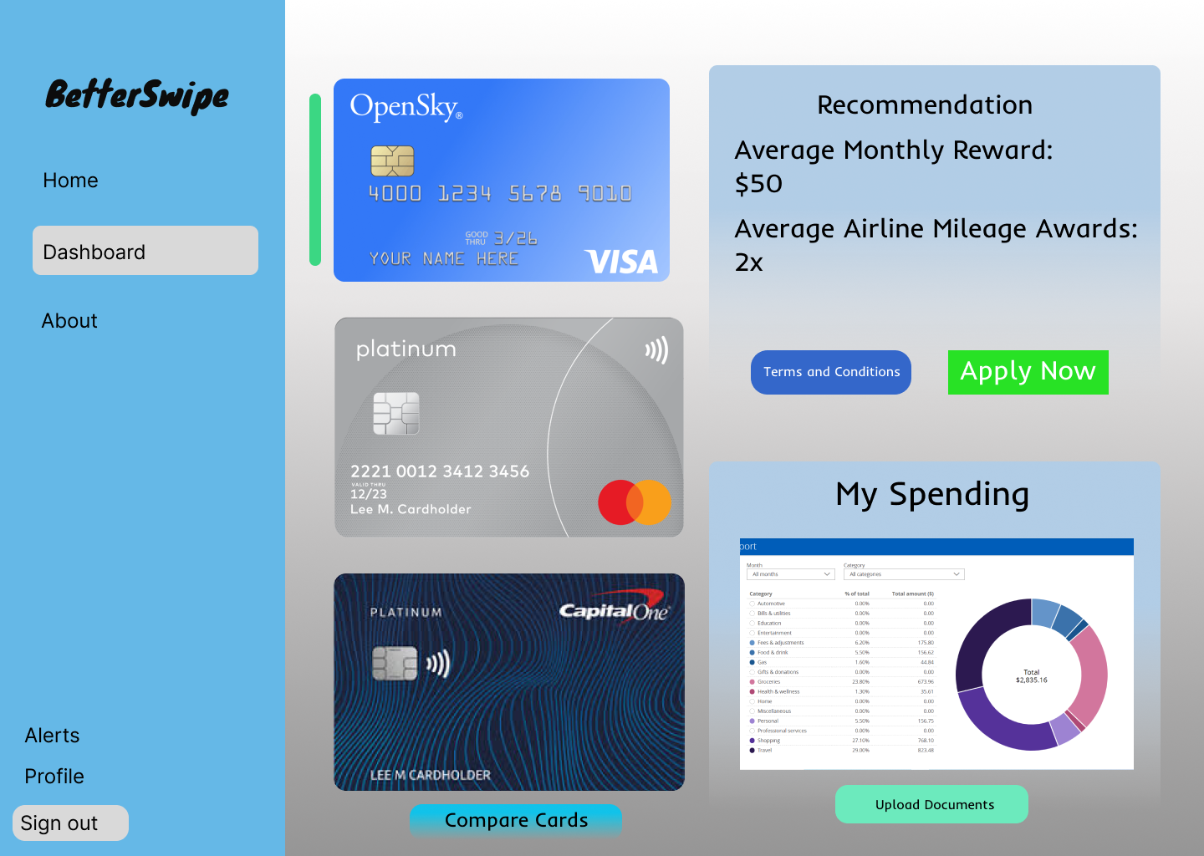
Dashboard: Prototype

Slide 12
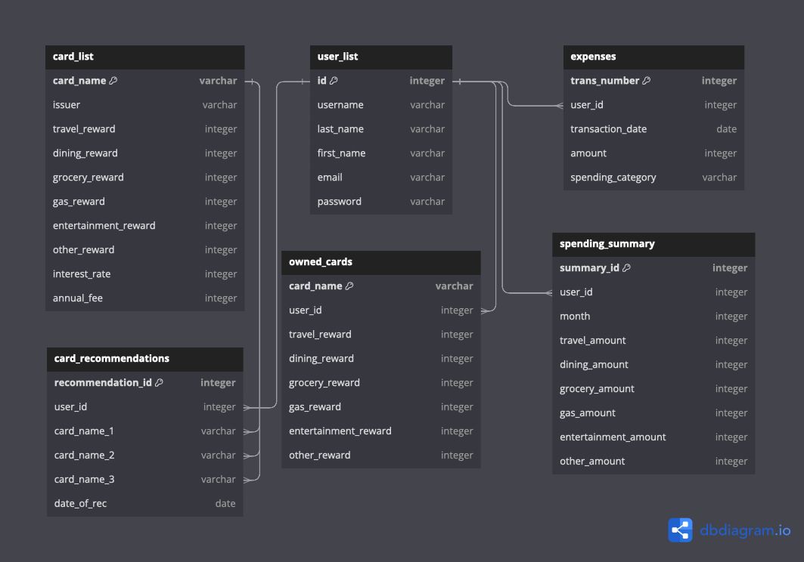
Database Implementation Concept (Structure/Approach)

Slide 13
Issues/Concerns/Challenges/Risks
Potential risk of user information having unauthorized access or being leaked
Constant monitoring of the user’s card information for updates
Application being unable to access API(s)
Team knowledge of software stack

